Slide 1
OAuth
By Cruz Gonzalez :)

Slide 2
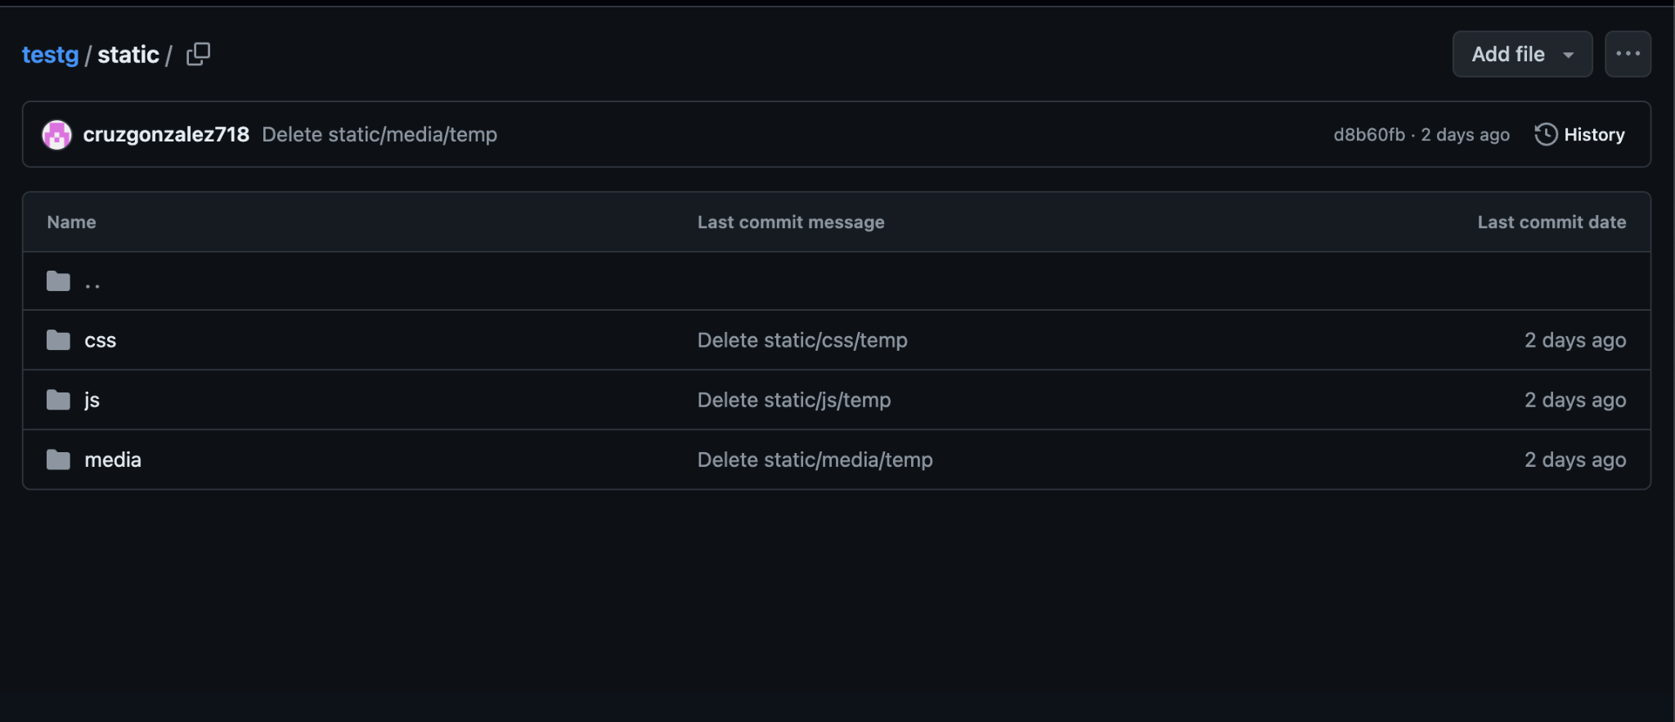
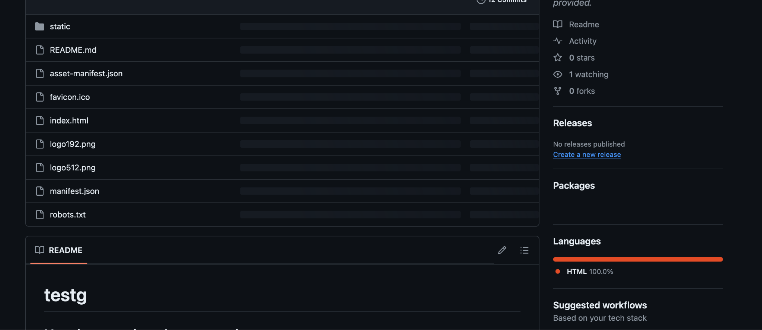
Github Files:

Slide 3
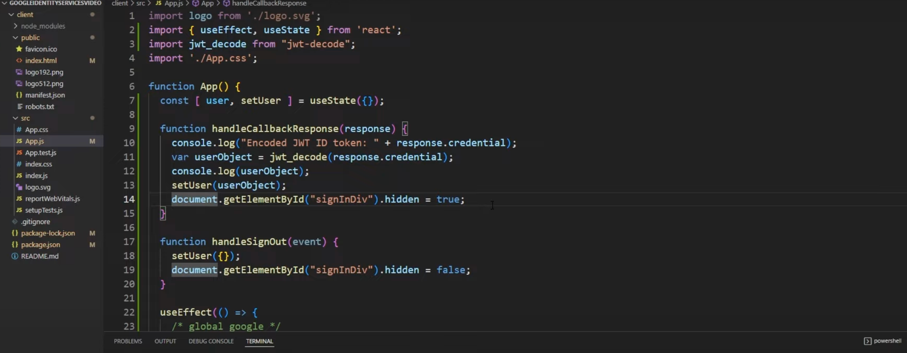
Here's a snippet of the code written that explains what to do when they see the page with a login and logout button

Slide 4
Under the index, this line of code will bring up the google prompt to login using google’s premade link

Slide 5
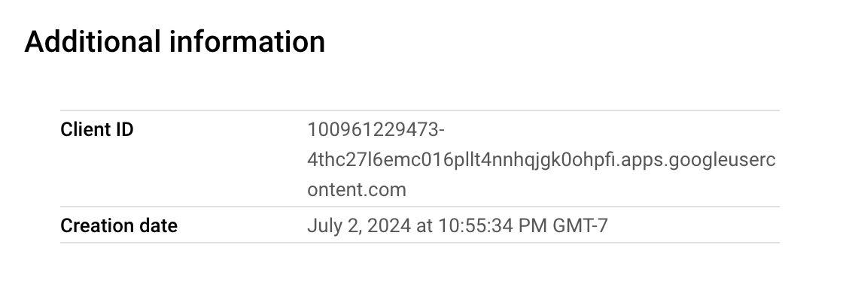
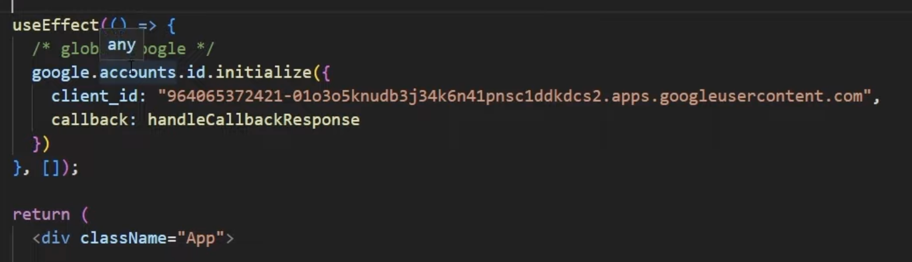
Credentials from Google Cloud:
We replace the code here with our client id for authentication

Slide 6
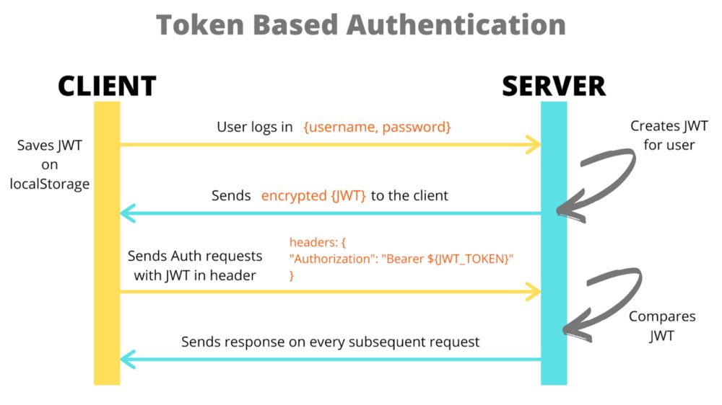
This version of the code reads a Json Web Token (JWT)
From that, we use a decoder we import to read the token and spits back info about the person such as name, profile picture, etc and verifies this. This then should theoretically log them in and prompt a logout once signed in.

Slide 7
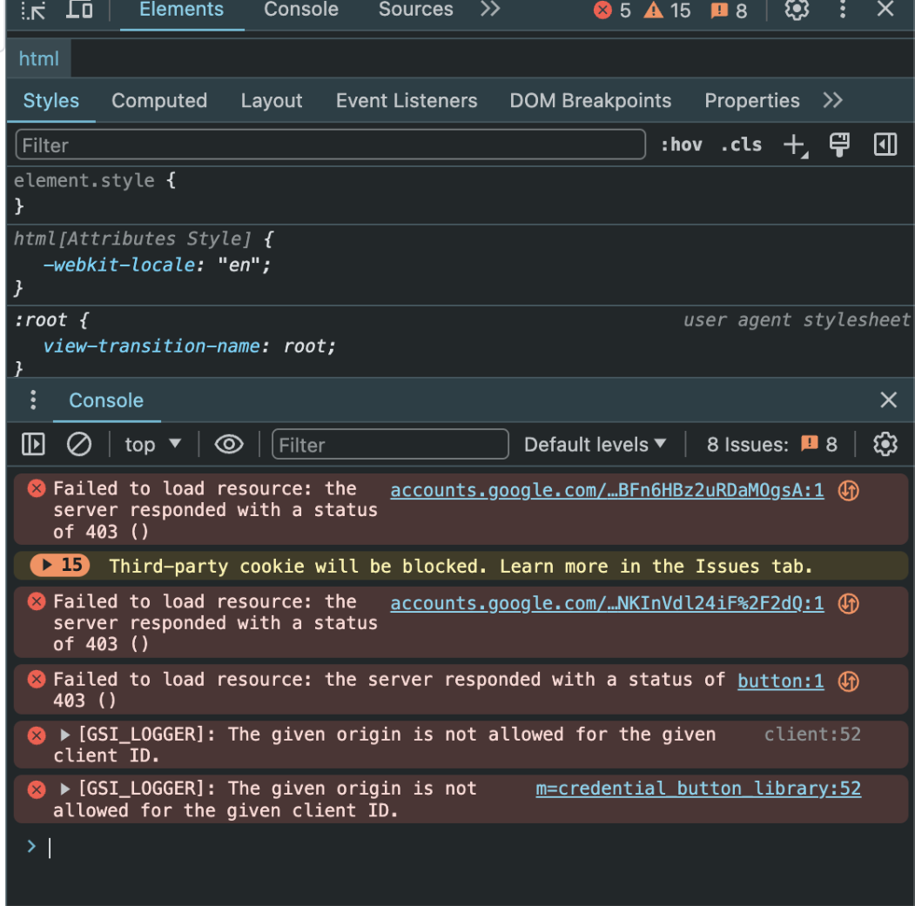
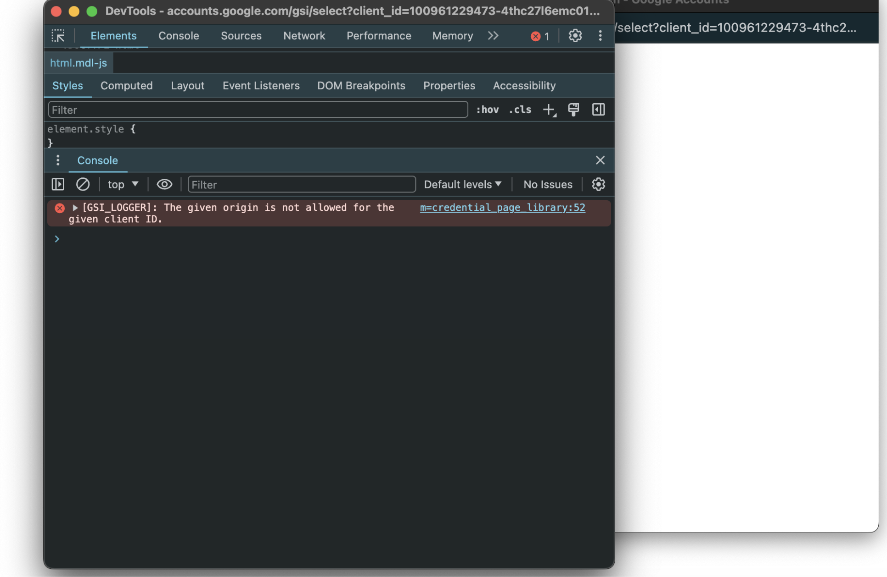
Problem:
We keep getting 403 errors which is basically an authentication error. The popu works but is not allowing the users access to login in the first place.

